Slide 1
The World of Certifications
What they do
What they don’t do
Notes:
As we will see, there are many, many certifications beyond the ones with which we are familiar.

Slide 2
Looking at 4 Certifications:
Fair Trade
Rainforest Alliance
UTZ
Starbucks
Notes:
Cannot do more in this short time

Slide 3
CREA’s Assessment Process
Our Assessment Tools: A series of Systemic Analysis (SA) Constructs to compare the different certifications in terms of standards and impact

Slide 4
Systemic Analysis
Systemic Analysis is a program created by CREA starting in 1997 that teaches a person how to do analysis using a set of Constructs or Tools which provide for the development of common language and the ability to analyze programs, policies and practices on an on-going basis.
Example 1: Legal, Ethical, Moral, Just
Example 2: Acceptable, Access-able, Afford-able
Example 3: Charity, Advocacy, Systemic Change

Slide 5
SA Tool 1: Choosing your Starting Point
Any analysis starts from a given perspective.
Possible perspectives include:
- ourselves
- our organization and its philosophy
- the community on the ground
- the consumer
- the farmers/workers doing the work
Notes:
Ourselves includes (our point of view; where we are and what we do)
Guarantee to consumer

Slide 6
Starting Point for This Analysis
Our analysis of the certifications
will start from
the experience of the farmers in agriculture

Slide 7
SA Tool 2: Cui Bono –Who Benefits?
Possible benefits:
Added income
Increased access to market
Better working conditions
Environmentally sustainable practices
Notes:
We can look up the specific codes from which each certification works. What we are looking at today is what actually happens on the ground, in country, and its impact on the farmers.

Slide 8
Price Benefits
Certification | Benefit
Fair Trade | Guaranteed minimum base price 10 cents (US) above market price for coffee
Rainforest Alliance | No guaranteed base price
UTZ | No guaranteed base price
Starbucks | 6% of coffee sold is fair trade certified with base price No guaranteed base price for rest of coffee
Notes:
Utz and RA are called “FT lite” in this category for not guaranteeing any minimum price or guaranteed price for the crop. This makes them very vulnerable to the international coffee market.
RA allow companies such as Chiquita and Kraft to tap into ethical consumer market without being more environmentally or worker friendly. Little impact on conditions under which workers work and are paid.
UTZ – no crop pre-financing
RA – do not provide pre-crop financing

Slide 9
Long Term Relationship with Buyer
Certification | Benefit
Fair Trade | Long term relationship with specific individual cooperatives
Rainforest Alliance | Long term relationship with specific farms and cooperatives
UTZ | No long term relationship
Starbucks | Long term relationship with specific farms
Notes:
This contributes to the trace-ability and track-ability of the products in bringing them to market. While all have a trace-ability system, the most documented is the one by UTZ which has a web-based track and trace system.

Slide 10
SA Tool 3: Power and Voice
Certification | Power | Voice
Fair Trade | Both buyer and cooperative have power since the buyer, such as Equal Exchange, needs the product and the cooperative needs to sell their product | Mutual relationship leads to communication
Rainforest Alliance | RA has power to require certain standards; farmers have little to no power
UTZ | UTZ has all the power as buyer and certifier
Starbucks | Starbucks has power to determine what % of each type of certified coffee is sold

Slide 11
Education and Training by Certifier
Certification | Benefit
Fair Trade | Certifier provides on-going training to provide better product
Rainforest Alliance | Certifier provides on-going training to provide better product
UTZ | No long term training or relationship
Starbucks | Certifier provides on-going training to provide better product

Slide 12
Environmental Issues
Shade grown?
Plantation?
Organic?
Notes:
UTZ allows for the use of GMO products and use of chemical fertilizers with a few basic regulations

Slide 13
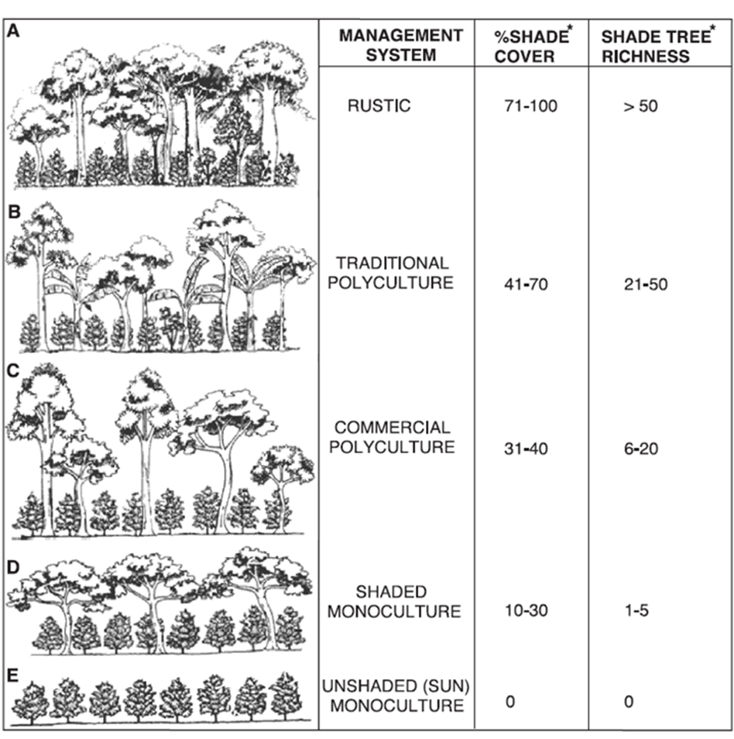
Understanding “Shade Grown”

Slide 14
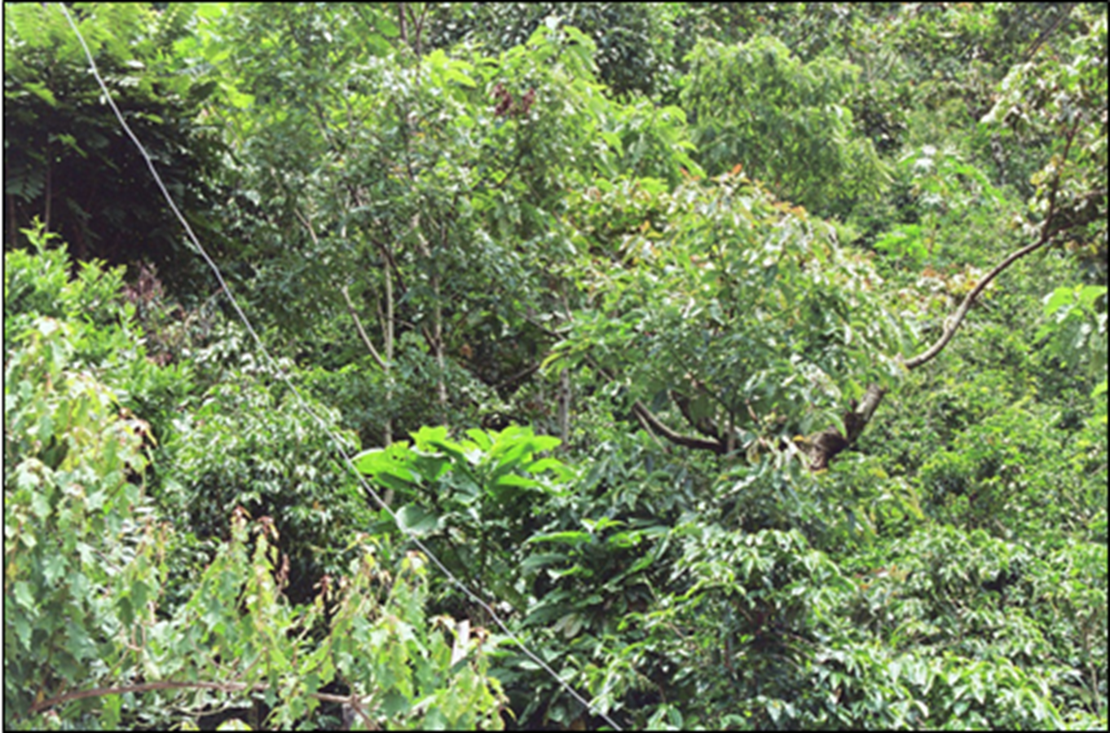
Shade grown in Guatemala mountains Fair Trade certified - Rustic

Slide 15
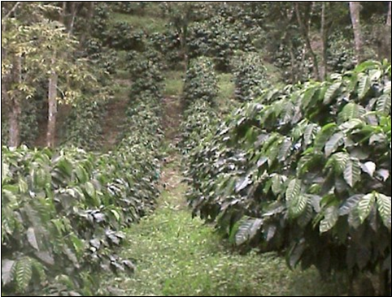

Slide 16
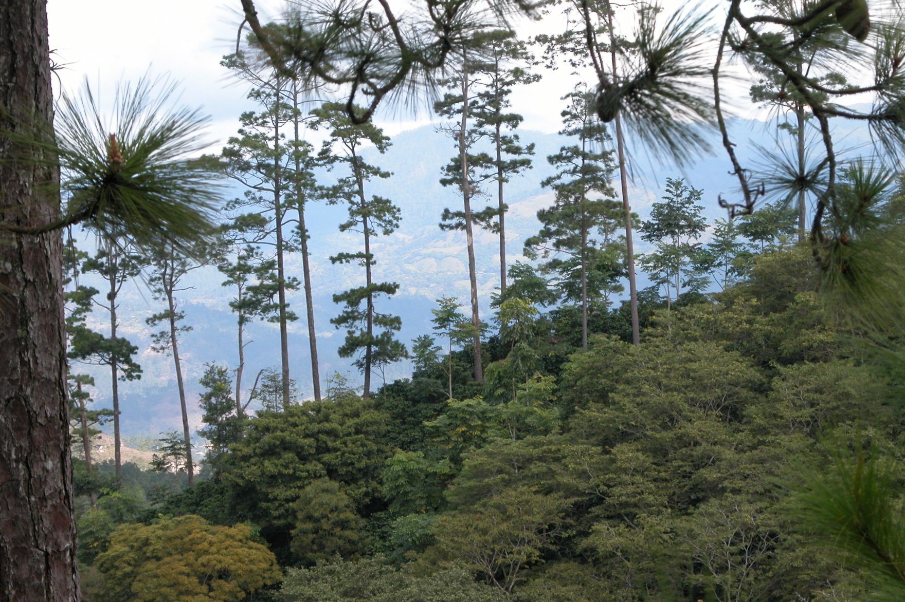
Shade grown in Chanmagua, Guatemala – RA certified Commercial monoculture

Slide 17
Labor Standards
Certification | Benefit
Fair Trade | Strong labor standards
Rainforest Alliance | Required labor standards but varying enforcement
UTZ | Weak labor standards requirement
Starbucks | Required labor standards with enforcement for the FT certified coffee
Notes:
UTZ labor standards – only national laws have to be followed

Slide 18
Access to Market
Certification | Benefit
Fair Trade | Fair Trade system provides increased access to market as well as active marketing
Rainforest Alliance | Certifier provides some increased access to market but not much
UTZ | No ensured access to market provided.
Starbucks | Starbucks provides market for product through its own sales as well as sale of its products in supermarkets, etc.

Slide 19
Certification through Auditing
Certification | Certifications | Fees
Fair Trade | Grower must be certified Seller must also be certified | Grower pays certification fee Seller pays certification fee
Rainforest Alliance | Grower must be certified | Grower pays certification fee
UTZ |  | Grower pays certification fee
Starbucks | Grower must be certified | Grower pays certification fee
Because of the fees for the different certifications,
farmers around the world are calling for one certification
that covers ALL the standards and their related requirements.
Providing certifications is BIG business for the certifiers.
Notes:
This is also where the enforcement or ensuring of the operationalization of the code and its requirements takes place.

Slide 20
Notes:
Encountering child labor: 2 choices – just not certify OR try to address the problem
Children not in school because lack school supplies:
Short term CREA providing school supplies for 3 years
Long term: what was needed to get kids out of the fields

Slide 21
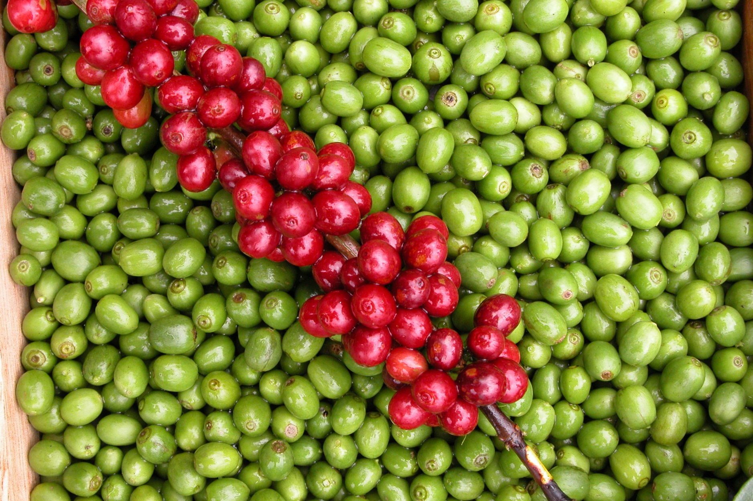

Slide 22
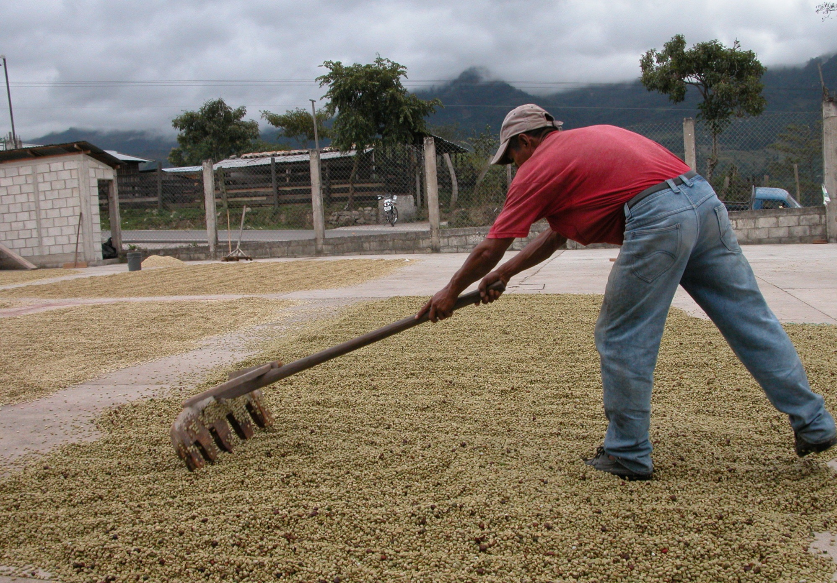

Slide 23
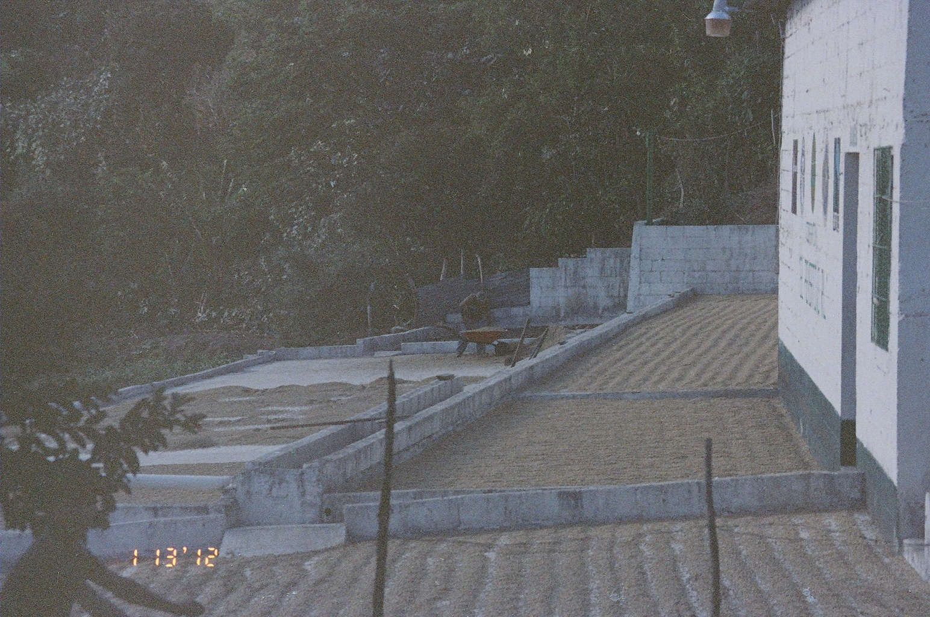

Slide 24
Some remaining questions:
Who is Fair Trade is in the US?
How can a certified farm or cooperative end up with child labor?
The following DVD from FEDECOCAGUA, Federation of Small Farmers and Cooperatives in Guatemala explains some of these things.

