Slide 1
Biosimilars
What they are and what they are not
© CREA 2011

Slide 2
Biosimilars
To understand what a biosimilar is and is not,
you need to understand
some basic chemistry and biochemistry

Slide 3
There are two basic types of chemistry:
Inorganic and Organic

Slide 4
Definition and Difference
Organic molecules based on the carbon atom
Inorganic molecules are not
These are the scientific definitions and have been used for decades
The use and misuse of the term “organic” has nothing to do with these two scientific definitions

Slide 5
For our understanding of biosimilars, there are a few core ideas we need to understand
1. Everything is made of atoms
2. Atoms come together to make molecules.
3. What holds molecules together are the electric charges of the atoms

Slide 6
Inorganic molecules are relatively simple They are formed by the exchange of electric charge which brings atoms together to form molecules

Slide 7
Example
Water – 2 hydrogen atoms each with an electric charge of +1
Then 2(+1) = +2
1 oxygen atom each with an electric charge
of -2
Then H₂O has electric charge of zero:
2(+1) = +2
1(-2) = -2
Therefore +2-2=0

Slide 8
Another example
Carbon dioxide 1 carbon atom with an electric charge of + or – 4
This means that carbon atoms can either combine with another atom with a charge of +4 or a different atom with -4
SO: 1 carbon atom = 1(+4)
2 oxygen atoms 2(-2)
Therefore CO₂ molecule has an electric charge of zero

Slide 9
But organic molecules are different:
Based on atoms which come together because of electric charge
BUT organic molecules are usually much, much larger
Organic molecules are based on the carbon atom which can combine in many ways based on shape as well as charge
THIS is the heart of the biosimilar conundrum

Slide 10
Simple methane
H
H C H
H
Methane Formula CH4 - 1 Carbon and 4 Hydrogen

Slide 11
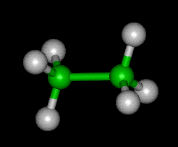
Some basic carbon shapes
1. In a chain
H H
H C C H
H H
Simple ethane
Note: the chains can be many atoms long

Slide 12
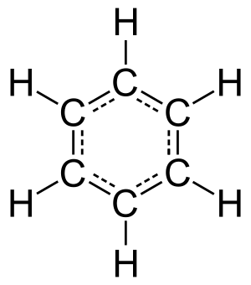
Simple Rings

Slide 13
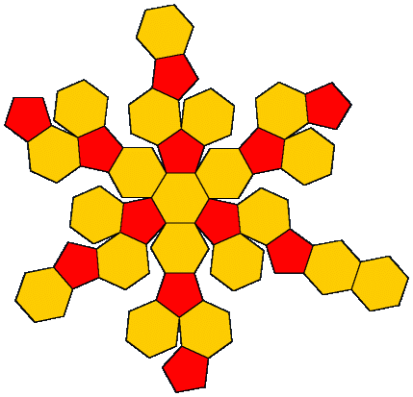
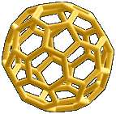
Geodesic Domes- Bucky Balls Some possibilities

Slide 14
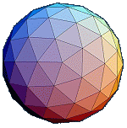
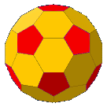
Some Other Possibilities

Slide 15
Key idea in each of these is shape
Organic molecules have two core components that affect what they do and how they react:
Content – what kinds of atoms are in the molecules
Shape - how the organic molecules physuically fit together

Slide 16
When organic molecules react with one another, they react based on composition and shape.
They need to “fit” together!
This fitting together is key to the biosimilar conundrum

Slide 17
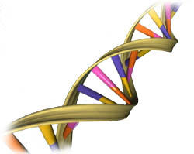
DNA
The most common DNA shape
illustrated by artists and scientists
looks a lot like a twisting ladder
that scientists call a double helix.
DNA also folds and coils itself
into more complex shapes. The coiled
shape makes it very small. In fact,
it is small enough to easily fit inside
and any of our cells. This is pretty amazing
when you find out that our own DNA,
if unfolded, would stretch out to a
length of six feet. That’s 6 feet in each cell.

Slide 18
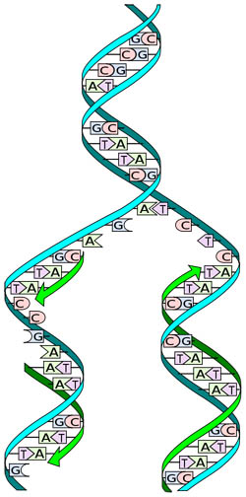
How DNA replicates or copies itself
DNA does more than store information. It is also able to make copies of itself.
To do this it first has to unzip the nitrogenous bases.
All the pairs of "AT" and "GC" are separated. The DNA now has two single strands.
At this point new pairs are made along with a phosphate backbone to create
two new copies DNA.
The copies will match because only "A" pairs with "T" and "G" pair only with "C".

Slide 19
How DNA functions
The sides of the DNA “ladder” serves as a backbone for the DNA molecule.
The rungs of the DNA ladder are composed of 4 organic bases:
A , T, C and G (known by their initials
A always pairs with T
G always pairs with C
The order in which the 4 bases are found is the CODE which gives the directions for making other molecules

Slide 20
The “words” of DNA
Each group of 3 bases codes for an amino acid
Examples: ATT AGA, CTG,
These “words” actually communicate to other molecules in the cells of any organism

Slide 21
Many of the most important molecules in living things are proteins whose existence depends on the right code being in their DNA
Proteins are composed of amino acids
The order of amino acids gives us the specific proteins that run organisms (living things) including humans

Slide 22
That order of amino acids allows the protein to fold in specific ways to create the shape of the molecule
Mutations are changes in the DNA which created changes in the code which orders the amino acids to make the protein molecules
Some times these mutations or changes are harmless because the base affected does not fit in an position that affects the folding of the molecule.
But many times, it DOES affect the folding and the resulting shape of the molecule

Slide 23
How does this relate to Biosimilars?
Biosimilars are organic molecules.
2. They usually have high molecular complexity. They are huge molecules
3. What is most important is the content of the biosimilar molecule AND the structure

Slide 24
BUT:
Unlike generics, which are identical to the original compound, biosimilars are what they say: similar
But similar does not MEAN the same
Most of the organic structure of the molecule (content) may be the same but the resulting structure may or may not be the same.

Slide 25
Core questions for any biosimilar:
In what way is each biosimilar the same as the original compound (medicine)
AND in what way is it different?

Slide 26
What makes Biosimilars different:
Complexity of the structure of the molecule
Complexity of the content of the molecule
Sensitivity to the manufacturing process
Why does this affect the biosimilar?

Slide 27
Manufacturers of biosimilars DO NOT have access to the content and process that the original manufacturer had and used:
It does not have access to:
The originator of the molecule's molecular clone (probably in another company).

Slide 28
2. The original cell bank from which it came/was produced.
3. The exact fermentation or other chemical process which was then used to process the original molecule they are trying to copy

Slide 29
4. There is no access to the commercial innovator product
5. There can be differences in impurities
6. There can be differences in breakdown products

Slide 30
THEREFORE the danger
is that the biosimilar
may not function the same way
as the original product

Slide 31
It may be useless
And in some instances can do harm

Slide 32
For more information
or permission to use this PowerPoint in public
Please contact CREA
crea-inc@crea-inc.org
860.527.0455

